Slide 1
ASL recognition in images
Group Members:
Muhammad Abdullah Bin Naeem (21-10153)
Khuzaima Bashir(21-10361)

Slide 2
Problem Statement
Our main concern is recognizing alphabets from ASL signs in still images
ASL is the main form of communication for people with impaired speaking and hearing abilities
As technology for image to text already exists we need to facilitate impaired people as well

Slide 3
DataSets
Source: Kaggle Title: ASL Alphabet Details: Images with ASL alphabets
Data Size: Approximately 85,000 images

Slide 4
Features
Filters: The features are mainly just the pixels and 2d matrix
Feature Extraction: There is no explicit feature extraction but we are detecting edges of the object in the image to identify the shape to identify the ASL letter. This is done by using conv2d and maxpooling layers.

Slide 5
Supervised
It is a supervised learning problem as we would need to label the results found by the algorithm. Furthermore during training we are providing both input and output which is a feature of supervised problems.

Slide 6
Chosen Model
Sequential Model
We are using sequential model as it is a very basic model which can be built layer by layer
Furthermore it is a model that is used for single input and single output which is perfect for our project as every image will only result in a single class label output

Slide 7
Making Sequential Model
Using 2d convolution layers and filters we will
Then after every few convolution we will use maxpooling layer to remove extra and comparatively less important info/noise
It will be followed by Batch Normalization
Then flatten is used to simplify image data
Dropout
Dense
At the end we compile

Slide 8
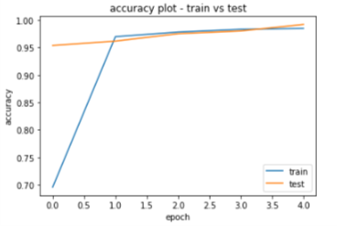
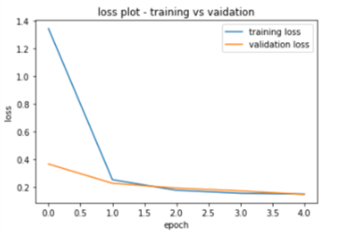
Initial Reference model
3 layers of (2 conv2d 1 maxpool) followed by batchnormalization

Slide 9
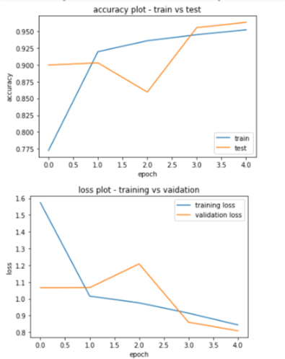
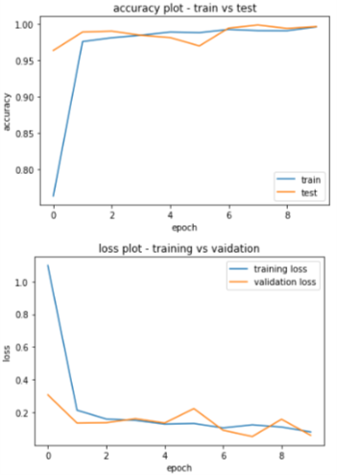
Test models
2 Conv2d 1 Maxpool
3(2 Conv2d 1 Maxpool) 10 epoch

Slide 10
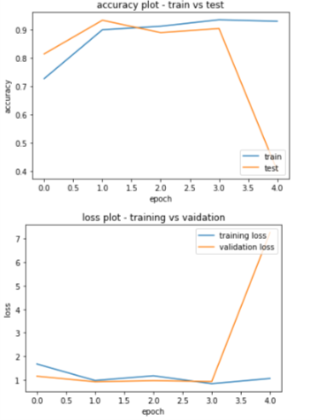
Test models
1 conv2d with 128 filters ,1 conv2d with 256 filters
3(2 Conv2d 1 Maxpool) linear activation

Slide 11
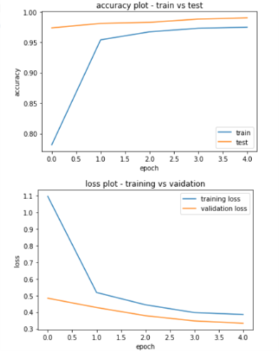
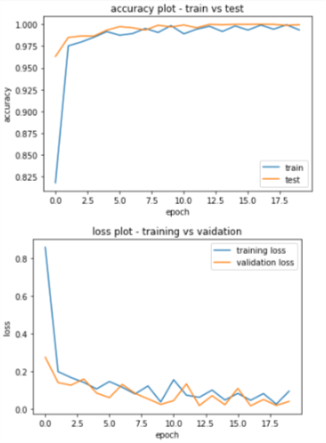
Test models
Without Batch Normalization
3(2 Conv2d 1 Maxpool) 20 epoch

